Slide 1
Arno Puder
Internet of Things
Introduction to Arduino-based Microcontrollers

Slide 2
Agenda
Platforms
Electronics 101
Arduino Sketches
Infrared
Cloud
Hardware Interfaces
Sensors & Actuators
Security
Companion page: https://github.com/apuder/iot-workshop

Slide 3

Internet of Things
IoT:
Term coined in 1999.
Inter-networking of physical devices.
Allows objects to be sensed or controlled remotely across existing network infrastructure.
First smart device: coke machine that reported its inventory (CMU, 1982)
Conceptual foundation in Mark Weiser’s vision of Ubiquitous Computing (1991)
IoT evolved due to a convergence of technologies such as ubiquitous wireless communication, real-time analytics, machine learning, commodity sensors, and embedded systems.
Application areas: environmental monitoring, healthcare, energy management, home automation, …
Platforms such as Raspberry Pi and Arduino enable DIY of IoT devices.
One of the biggest challenges is security.

Slide 4

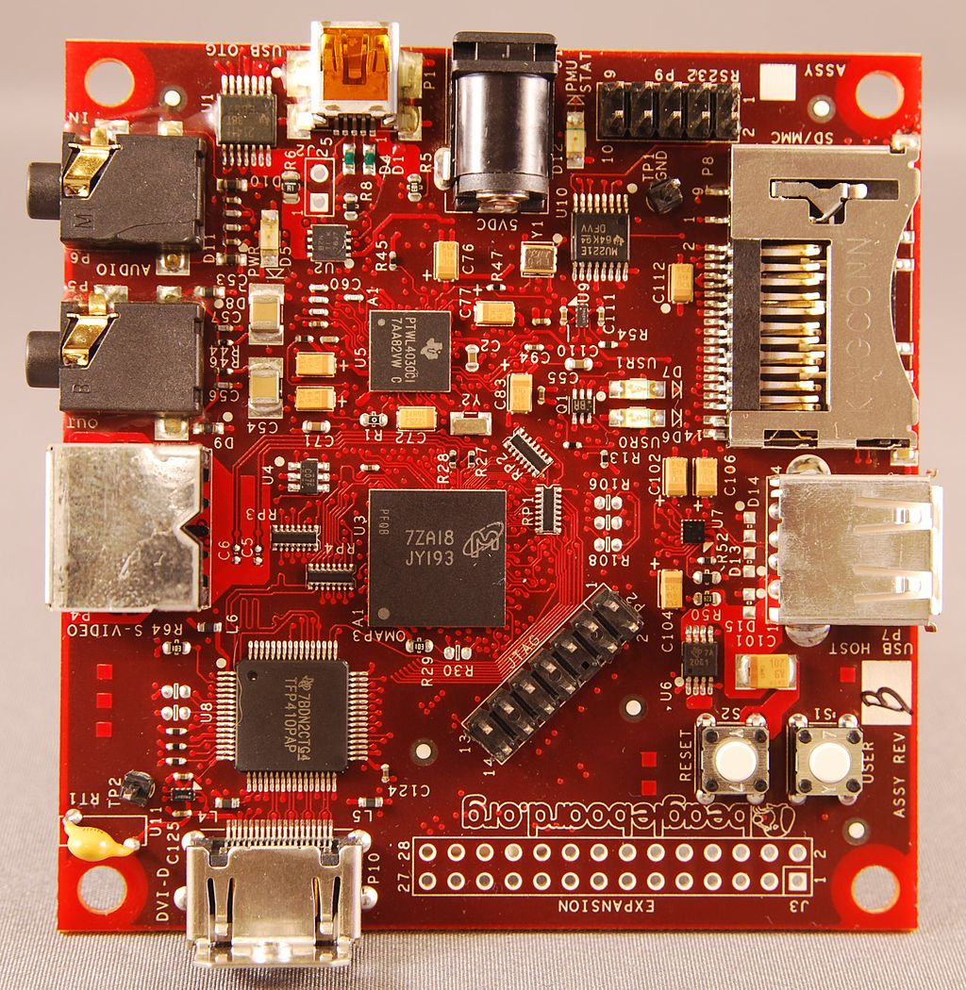
BeagleBoard
Low-power, Open Source, single board computer produced by TI since 2008.
Cost: $95 - $149
Processor: ARM Cortex-A8 CPU.
Frequency: 600 MHz – 1GHz
Memory: 128 MB – 512 MB
Power consumption: 2 W.
Runs Linux, Minix, FreeBSD, OpenBSD.
Ports: USB, RS232, I2C, SPI, …
BeagleBone:
Since 2011.
Barebone development board.
microSD slot.
On-chip Ethernet.
Capes: LCD touchscreen, battery, breakout, …

Slide 5
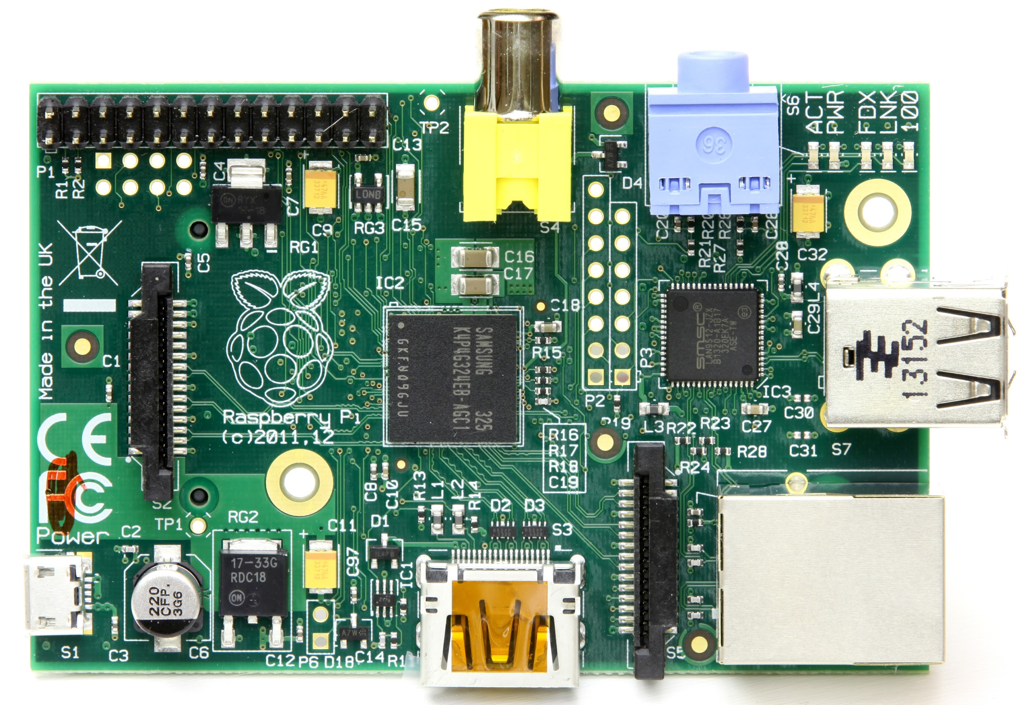
Raspberry Pi
Credit card sized computer devel- oped by Raspberry Pi Foundation.
First released in 2012.
Developed to promote teaching of basic computer science.
Its very low cost ($25) and low powered.
It comes with Broadcom SoC (System-on-Chip) which includes an ARM CPU and a GPU.
256MB to 1GB RAM.
SD card to store the OS and other data.
Runs Linux.
Features common interfaces: GPIO, UART, I2C, and SPI.
Homepage: https://www.raspberrypi.org/

Slide 6

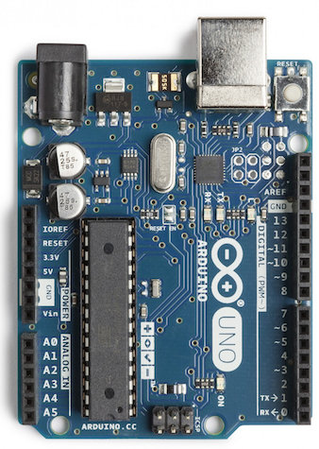
Arduino
Open source specification for a programmable microcontroller.
Started in 2003 in Italy.
Main purpose is to interface with sensors and actuators via GPIO/I2C and SPI.
CPUs: Atmel AVR, ARM Cortex, Intel Quark (x86)
Does not run an operating systems!
Arduino Uno R3:
CPU: ATmega328P @ 16 MHz
Flash memory: 32 kB
SRAM: 2 kB
Interface: GPIO, UART, SPI, I2C.
Size: 68 x 53 mm
Power consumption: 225 mW
Arduinio Pro Mini: 15 μW - 12 mW (4 years on a 9V battery)
Homepage: https://www.arduino.cc/

Slide 7
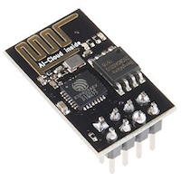
ESP8266
Low-cost microcontroller including full TCP/IP stack.
Produced by Shanghai-based Chinese manufacturer, Espressif Systems.
CPU: 32-bit RISC Tensilica Xtensa L106 @ 80 MHz.
RAM: 64 kB for instructions; 96 kB of data.
WiFi:
IEEE 802.11 b/g/n
WEP or WPA/WPA2 authentication, or open networks.
Interface: 16 GPIO pins, SPI, I2C, UART, 10-bit ADC.
Power consumption: 250 μW to 660 mW.
Size: 25 x 15 mm.

Slide 8
Current/Voltage
Electronic devices depend on the movement of electrons.
The amount of electrons moving from one molecule to another is called Current which is measured in Amps.
The difference in potential (the number of free electrons) between two points is called Electromotive Force (EMF) which is measured in Volts.
Plumbing analogy:
Voltage is equivalent to the water pressure.
Current is equivalent to the flow rate.
+
5V
-
2A

Slide 9
Electronic Circuit
Electrons flow from the negative terminal of the battery through the circuit to the positive terminal.
There needs to be a complete circuit for current to flow.
+
+
-
-
No current Light is off
Current will flow
Light is on

Slide 10
Resistance
Materials that allow easy movement of electrons are called Conductors.
E.g., copper, silver, gold, aluminum.
Materials that do not allow easy movement of electrons are called Insulators.
E.g., glass, paper, rubber.
Materials that are neither good conductors or good inductors provide Resistance to the movement of electrons.
E.g., carbon.
The unit of resistance is Ohm (Ω).

Slide 11
Ohm’s Law
A (linear) resistor is an element for which: where: I = Current in Amps
U = EMF in Volts
R = Resistance in Ohms
The equation is known as Ohm’s Law.
Plumbing analogy: diameter of the pipe.
R
U
I

Slide 12
Ohm’s Law: Example
U_{Battery} = 5V
R = 100Ω
What is the current?
I = 0.05A = 50mA
+
U_{Battery}
R
-
I

Slide 13
Open and Short Circuits
An open circuit between A and B means I = 0A
Voltage across an open circuit: any value.
An open circuit is equivalent to R = ∞ Ω
A short circuit between A and B means U = 0V
Current through a short circuit: any value.
A short circuit is equivalent to R = 0Ω

Slide 14
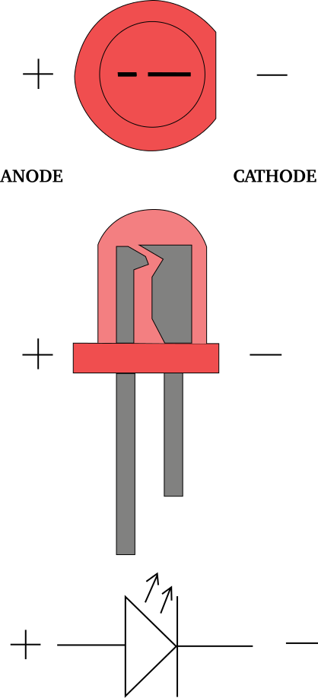
LED
LED: Light Emitting Diode.
Invented in 1927.
Working principle: Electroluminescence.
Allows current to flow in only one direction (anode connected to positive and cathode to negative terminal).
Available in different colors and as RGB LEDs.
Forward drop: maximum allowable voltage.
Applications:
Lighting.
7-segment displays.
Infrared LEDs for remote controls.

Slide 15
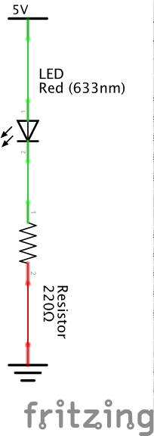
LED and Resistance
Compute the resistance to protect a LED (Light Emitting Diode) from burnout:
V_{S} = 5V
V_{LED} = 2.2V (forward drop)
I_{LED} = 16 mA
R = 175Ω
R_{approx} = 220Ω (red-red-brown)
2.2V
2.8V
http://www.ohmslawcalculator.com/led-resistor-calculator

Slide 16
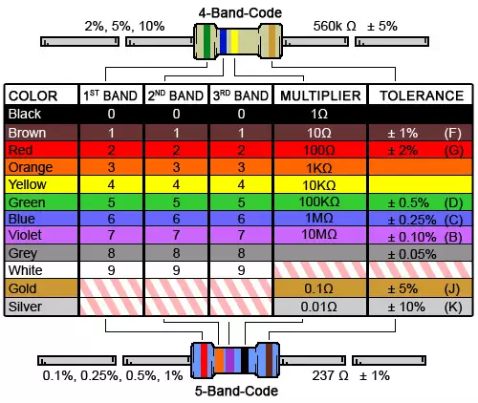
Resistor Color Codes
https://www.digikey.com/en/resources/conversion-calculators/conversion-calculator-resistor-color-code-4-band

Slide 17
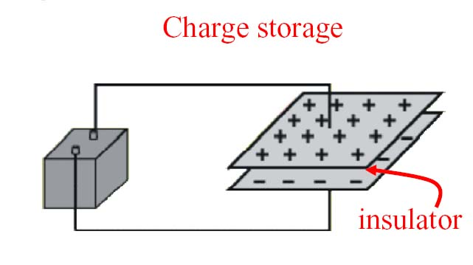
Capacitors
A device that stores electrons.
A basic capacitor is made up of two conductors separated by an insulator and dielectric.
The dielectric material is an insulator therefore no current flows through the capacitor.
Dielectric material
Battery
Plate 2
Capacitor
Charge is stored on the plates of the capacitor.
Equation:
Q = CV
Units:
Farad = Coulomb/Voltage
Farad is abbreviated as F
Plate 1

Slide 18
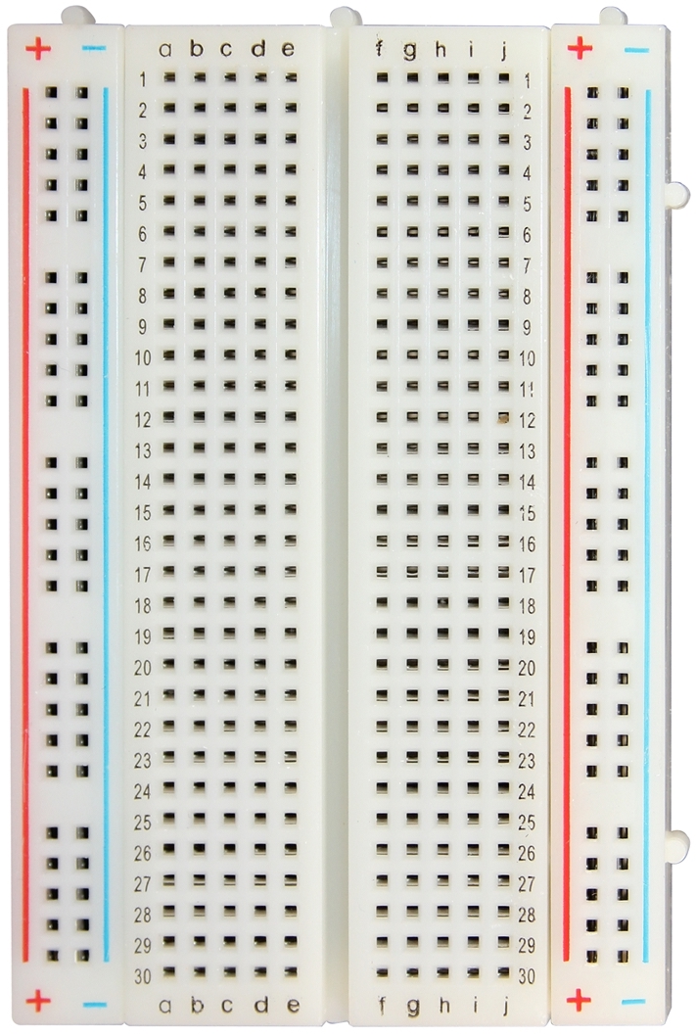
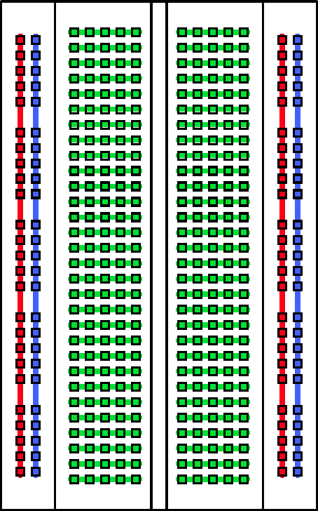
Breadboards
Breadboards are used for fast prototyping.
Allows to build an electronic circuit without soldering.
Pins are connected as shown in the schematic on the right.

Slide 19
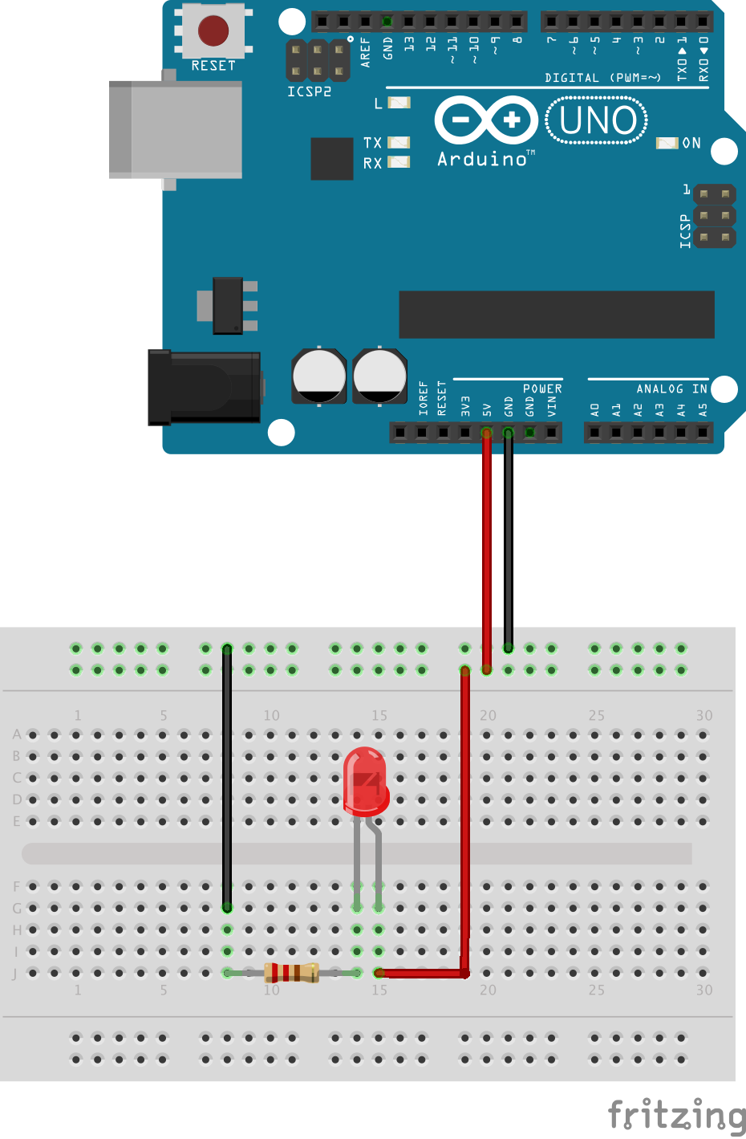
“Hello World” Electronics
Simple electronic circuit that powers a LED (Light Emitting Diode).
Arduino is only used to provide power to the circuit:
Ground: black wire.
5V: red wire.
220Ω resistor is used to avoid burnout of the LED.
Note: polarity of LED is important!

Slide 20
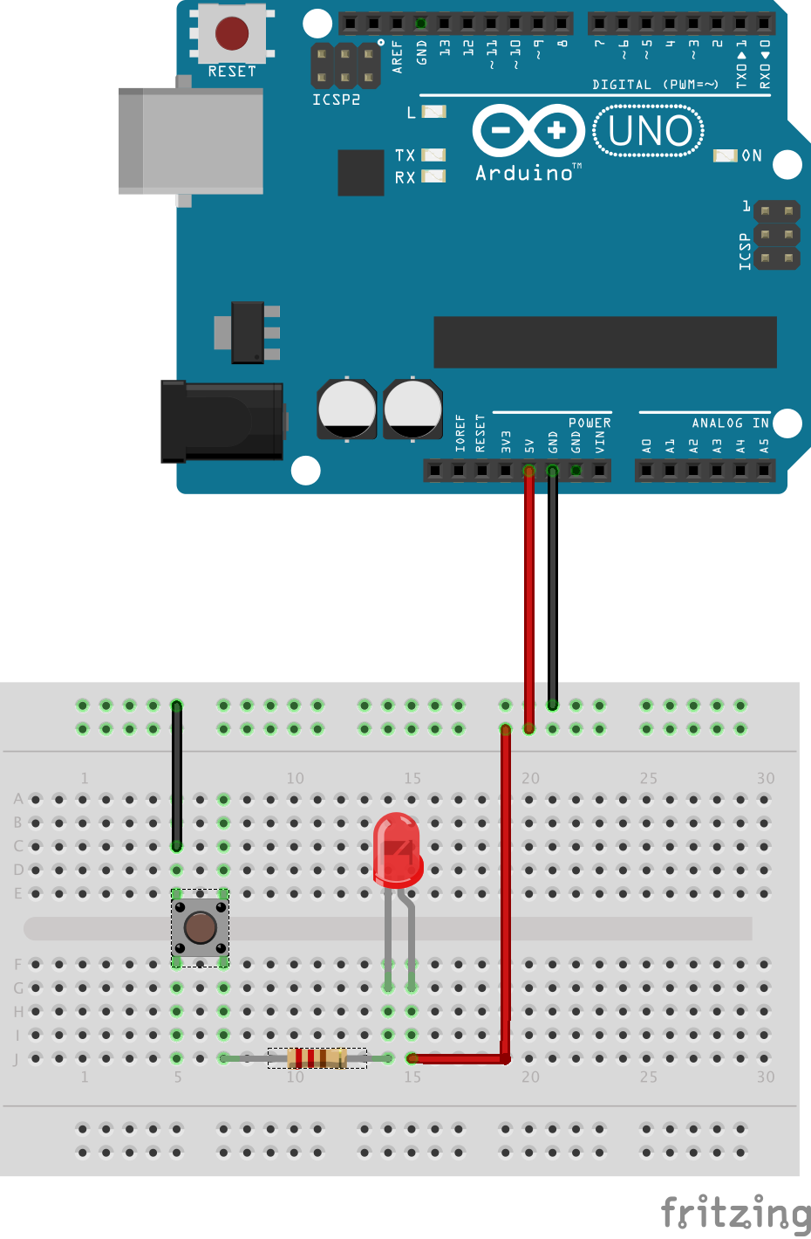
Push Button
Simple electronic circuit using a LED and a push button.
Arduino is only used to provide power to the circuit.
LED will only turn on when the push button is pressed.

Slide 21
Debounce
XXX
https://www.allaboutcircuits.com/technical-articles/switch-bounce-how-to-deal-with-it/

Slide 22
General Purpose Input/Output (GPIO)
Generic pin with no pre-defined purpose.
Can be configured either as input or output.
Programmable interface:
Read state of a binary device (e.g., push button).
Control on/off state of a binary output device (e.g., LED)
Arduino Uno:
14 digital GPIO pins.

Slide 23
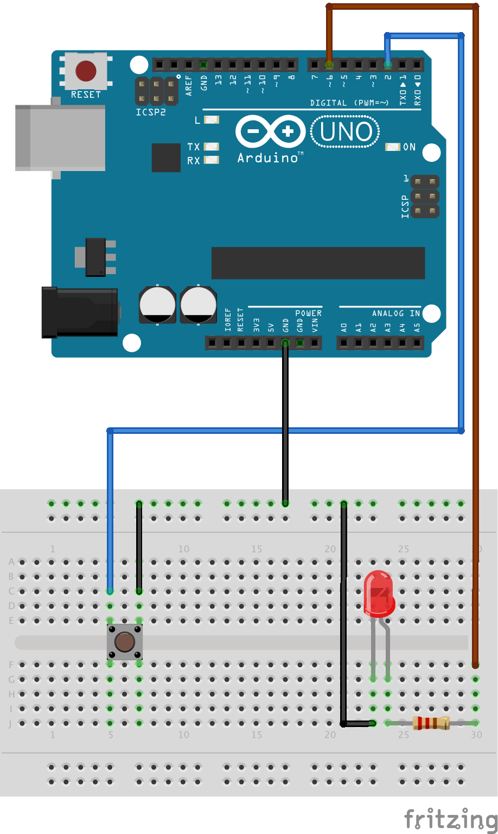
“Hello World” Arduino
First circuit that makes use of the Arduino.
Push button is connected to GPIO pin 2.
LED is connected to GPIO pin 6.
Both LED and the push button are also connected to ground to form a complete circuit with their respective GPIO pins.
Pushing the button will not turn on the LED.
Arduino needs to be programmed to implement desired behavior.

Slide 24
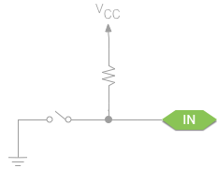
Pull-Up Resistor
Floating input:
Digital input not actively connected to any signal.
Are susceptible to electromagnetic interference.
Can cause unpredictable readings.
Pull-up resistor:
Ensure that the line is driven to a stable value, even when nothing else is connected.
Guarantee that each signal has a stable default state that the rest of the system can rely on, without significantly affecting the input or output signal directly.
Pull-up resistor values are typically between 1kΩ and 10kΩ.
Arduino has built-in pull-up resistors on its GPIO pins.

Slide 25
Arduino Sketches
Programs for the Arduino are called Sketches.
Sketches can be written in C/C++.
No operating system!
Only one thread of execution.
Support for common POSIX functions (e.g., malloc(), strlen(), etc)
IDE automatically includes common header files.
Popular IDEs:
Arduino IDE.
Atom with PlatformIO.
// Basic template for
// a sketch
void setup() {
// ...
}
void loop() {
// ...
}
setup()
loop()
loop()
loop()
loop()
…
Time

Slide 26
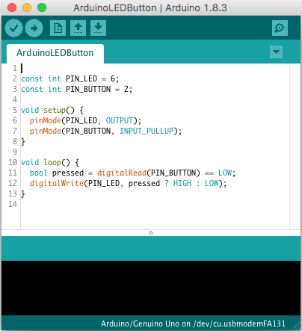
Arduino IDE
Download free Arduino IDE: https://www.arduino.cc/en/Main/Software
Configuration:
Tools > Board > Arduino/Genuino Uno
Tools > Programmer > AVR ISP
Tools > Port > /dev/XXX
Note: the Arduino needs to be connected to the laptop in order for it to show up under Tools > Port.

Slide 27
Sketch for Button/LED Circuit
const int LED_PIN = 6;
const int BUTTON_PIN = 2;
void setup() {
pinMode(LED_PIN, OUTPUT);
pinMode(BUTTON_PIN, INPUT_PULLUP);
}
void loop() {
bool pressed = digitalRead(BUTTON_PIN) == LOW;
digitalWrite(LED_PIN, pressed ? HIGH : LOW);
}
This sketch assumes the wiring as shown on the “Hello World” for Arduino slide.
GPIO pins can be configured either as input (INPUT_PULLUP) or output (OUTPUT) via pinMode()
digitalRead() can return either HIGH or LOW. For a pin configured as INPUT_PULLUP it will return LOW when the button is pressed. It will also activate an internal pull-up resistor on that pin.
The value of HIGH or LOW can be set for an output pin via digitalWrite()
This sketch will constantly update the LED with each call to loop()

Slide 28
Blinking LED
const int LED_PIN = 6;
void setup() {
pinMode(LED_PIN, OUTPUT);
}
void loop() {
digitalWrite(LED_PIN, HIGH);
delay(500);
digitalWrite(LED_PIN, LOW);
delay(250);
}
Function delay() will sleep for the number of milliseconds provided as a parameter.
This sketch will repeatedly first turn the LED on for half a second (500ms) and then off for a quarter of a second (250ms).
One iteration of function loop() takes a little more than 750 ms.

Slide 29
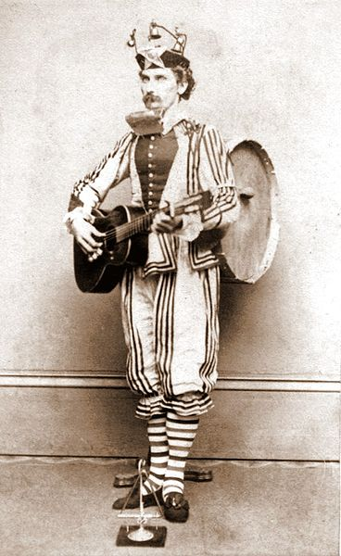
Concurrent Jobs
Problem statement:
Two LEDs, one green and one red, should blink in different intervals.
Red LED should be on for 0.5s and off for 0.25s.
Green LED should blink in 0.1s interval.
Ordinarily one would create two processes/threads that each control one LED.
Since there is only one thread of execution, it is not easy to do two different jobs at the same time.

Slide 30
void loop() {
digitalWrite(LED_RED_PIN, HIGH);
digitalWrite(LED_GREEN_PIN, HIGH);
delay(100);
digitalWrite(LED_GREEN_PIN, LOW);
delay(100);
digitalWrite(LED_GREEN_PIN, HIGH);
delay(100);
digitalWrite(LED_GREEN_PIN, LOW);
delay(100);
digitalWrite(LED_GREEN_PIN, HIGH);
delay(100);
digitalWrite(LED_GREEN_PIN, LOW);
digitalWrite(LED_RED_PIN, LOW);
delay(100);
digitalWrite(LED_GREEN_PIN, HIGH);
delay(100);
digitalWrite(LED_GREEN_PIN, LOW);
delay(50);
digitalWrite(LED_GREEN_PIN, HIGH);
// Continue like this for full
// period (3 seconds)
}
Period of red LED is 750ms.
Period of green LED is 200ms.
Period of both LEDs is the least common multiple of 750 and 200: The pattern of the two blinking LEDs repeats itself after 3 seconds.
One iteration of the loop() function takes 3 seconds and covers one complete on/off cycle for both LEDs.
Spaghetti code!
Red LED
Green LED
0
0.5
1
1.5
2
Covered by code shown

Slide 31
const int LED_PIN = 6;
const int LED_ON_TIME = 500;
const int LED_OFF_TIME = 250;
int ledState = LOW;
unsigned long tsLastStateChange = 0;
void setup() {
pinMode(LED_PIN, OUTPUT);
}
void loop() {
unsigned long delta = millis() –
tsLastStateChange;
switch(ledState) {
case LOW:
if (delta > LED_OFF_TIME) {
ledState = HIGH;
tsLastStateChange = millis();
}
break;
case HIGH:
if (delta > LED_ON_TIME) {
ledState = LOW;
tsLastStateChange = millis();
}
break;
}
digitalWrite(LED_PIN, ledState);
}
Code shown here makes one LED blink without the use of delay()
Blink pattern:
On-time: 500ms
Off-time: 250ms
Sketch makes use of function millis() that returns the number of milliseconds since the Arduino booted.
millis() will wrap-around to 0 after 50 days.
tsLastStateChange keeps track of the timestamp when the state of the LED was changed last.
ledState keeps track of the current state of the LED (off or on)
This pattern is sometimes referred to a state machine.
Since there is no delay(), one iteration of loop() will only take a fraction of a second.

Slide 32
class BlinkingLED {
const int LED_PIN;
const int LED_ON_TIME;
const int LED_OFF_TIME;
int ledState = LOW;
unsigned long tsLastStateChange = 0;
public:
BlinkingLED(int pin, int onTime, int offTime) :
LED_PIN(pin), LED_ON_TIME(onTime),
LED_OFF_TIME(offTime) { pinMode(LED_PIN, OUTPUT);}
void update() {
unsigned long delta = millis() - tsLastStateChange;
switch(ledState) {
case LOW:
if (delta > LED_OFF_TIME) {
ledState = HIGH;
tsLastStateChange = millis();
}
break;
case HIGH:
if (delta > LED_ON_TIME) {
ledState = LOW;
tsLastStateChange = millis();
}
break;
}
digitalWrite(LED_PIN, ledState);
}
};
Class BlinkingLED is an object-oriented version to blink a LED for a given on/off pattern.
Uses the same technique as outlined on the previous slide.
Constructor takes the pin number as well as the desired on- and off-time pattern.
Pin is configured as OUTPUT in the constructor.
Method update() will turn the LED off or on using millis()
Method update() is essentially the implementation of loop() on the previous slide.
Global variables such as LED_PIN on the previous slide have been turned to private members of class BlinkingLED.

Slide 33
Two Blinking LEDs
BlinkingLED ledRed(6, 500, 250);
BlinkingLED ledGreen(7, 100, 100);
void setup() {}
void loop() {
ledRed.update();
ledGreen.update();
}
With the help of C++ class BlinkingLED, two instances ledRed and ledGreen can be declared, each with the desired individual on/off patterns.
loop() function just calls the respective update() methods.
This is a common programming pattern for environments with only one execution thread: each sub-module contributes an update() method.

Slide 34
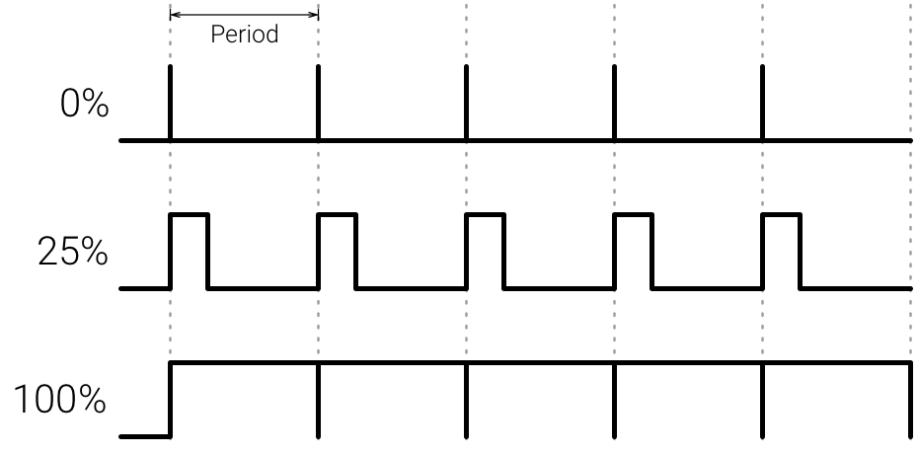
Pulse Width Modulation (PWM)
Technique to achieve analog results with digital means.
On/off pattern can simulate voltages in between full on (5 Volts) and off (0 Volts) by changing the portion of the time the signal spends on versus the time that the signal spends off.
E.g., by asserting an output pin to HIGH for 25% of the time at high frequency, the brightness of a connected LED is reduced proportionally. Typical period time is 2ms (500Hz).
Period that the signal is high is also referred to as duty cycle.
GPIO pins that support PWM are prefixed with “~”.

Slide 35
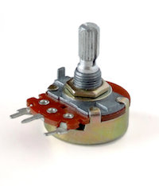
Potentiometer
Three-terminal resistor.
Sliding or rotating contact forms an adjustable voltage divider.
Usages:
Volume controls.
Joysticks.
+
R
-
U

Slide 36
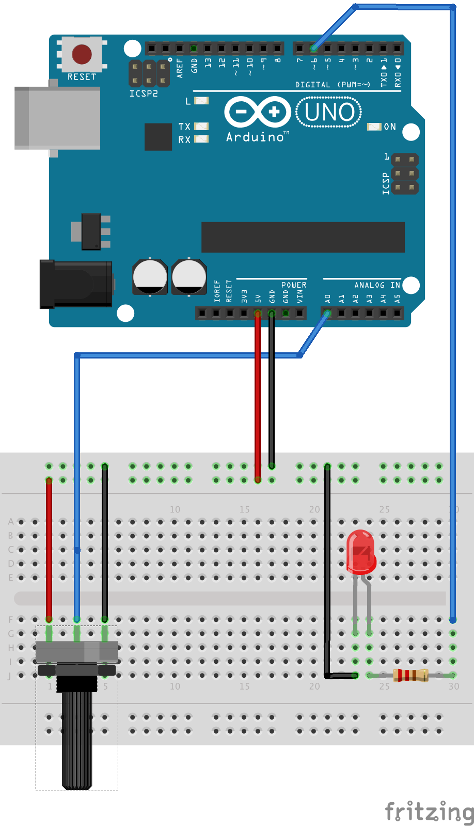
Analog Data
const int LED_PIN = 6;
const int POTENTIOMETER_PIN = A0;
void setup() {
pinMode(LED_PIN, OUTPUT);
}
void loop() {
// val will be between 0 and 1023
int val = analogRead(POTENTIOMETER_PIN);
// (val / 4) will be between 0 and 255
analogWrite(LED_PIN, val / 4);
}
GPIO pins marked with “~” support PWM. For those pins analogWrite() can be used.
Special pins can be used for analog input. Voltage levels from 0V to 5V are mapped to numbers 0 to 1023.
analogRead() can only be used for analog pins prefixed with “A” (not GPIO pins)
Potentiometer used in the circuit is a variable resistor to change the input voltage on the analog pin A0.

Slide 37
Button/LED Sketch using Interrupts
const int LED_PIN = 6;
const int BUTTON_PIN = 2;
void isr_button() {
bool pressed = digitalRead(BUTTON_PIN) == LOW;
digitalWrite(LED_PIN, pressed ? HIGH : LOW);
}
void setup() {
pinMode(LED_PIN, OUTPUT);
pinMode(BUTTON_PIN, INPUT_PULLUP);
int irq = digitalPinToInterrupt(BUTTON_PIN);
attachInterrupt(irq, isr_button, CHANGE);
}
void loop() { /* Do nothing */ }
Pins 2 and 3 on the Arduino Uno can generate interrupts.
This sketch attaches an ISR specified by function pointer isr_button to be called whenever there is a state change on BUTTON_PIN.
Notes:
ISRs should execute very fast. Do not use delay() while inside the ISR.
Interrupts are turned off within an ISR.
Return value of millis() will not change while inside the ISR.

Slide 38
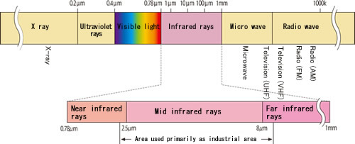
Infrared Radiation
Electromagnetic radiation (EMR) with longer wavelengths than those of visible light.
Invisible to the human eye.
Applications: night vision, remote controls, motion detection, …
http://www.apiste-global.com/fsv/technology_fsv/detail/id=1188

Slide 39
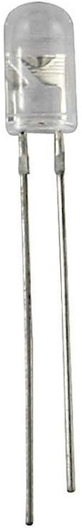
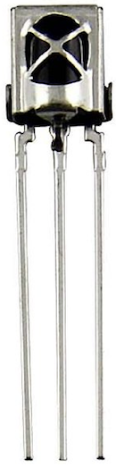
IR Diode & Receiver
IR Diode:
Emits infrared radiation.
Polarity is important.
Needs current-limiting resistor.
IR Receiver:
V_{cc}: 3-5V
V_{out} pin is asserted to low when IR signal is detected.
IR signal needs to be modulated at 38 kHz.
V_{out} GND V_{cc}
Anode Cathode

Slide 40
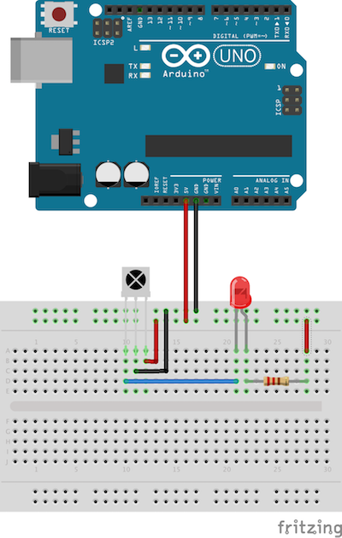
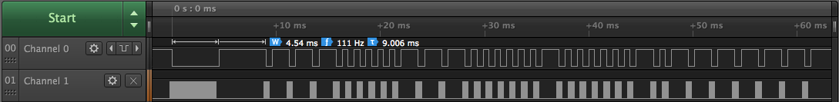
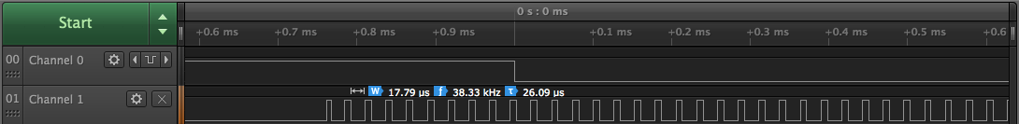
IR Signals
Pointing a TV remote to the IR receiver and pushing a button will light up the LED.
Each button of a TV remote generates a unique high/low pattern.
Channel 0 shows the high/low pattern of the OFF button of a Samsung TV remote.
Channel 1 shows the modulated version of the signal.
Bottom screenshot is a zoomed-in version of the top screenshot: the first 4.54ms shown in channel 0 (top) is a sequence of 17.79 μs high/low patterns shown in channel 1 (bottom)

Slide 41
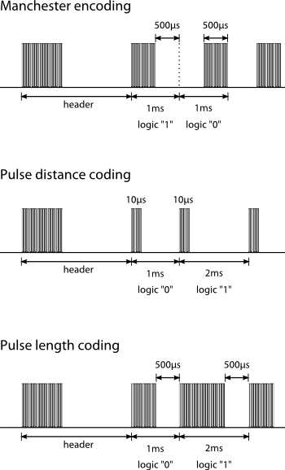
Samsung TV remote uses Pulse Distance Coding.
OFF button on the previous slide encodes the binary value: 11100000111000000100000010111111
Hex: 0xE0E040BF
http://irq5.io/2012/07/27/infrared-remote-control-protocols-part-1/
http://www.vishay.com/docs/80071/dataform.pdf

Slide 42
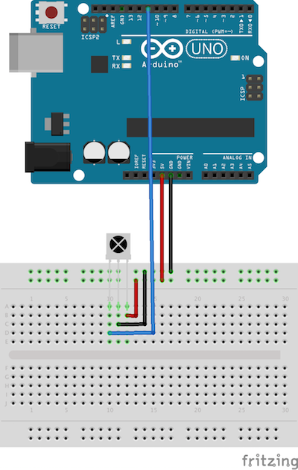
Receiving an IR Signal
Library IRremote allows to capture the high/low pattern of an IR sender (e.g., TV remote)
Output pin of the IR receiver is connected to pin 11 of the Arduino.
Check companion web page for the source code of the sketch.
The sketch will print out the high/low pattern as an array of numbers to the Serial Monitor.
Each number is in micro-seconds.
Array below reflects the pattern from the previous slide.
unsigned int rawData[] = {4500, 4450, 600, 1600, 600, … , 1650, 600, 1600, 600};

Slide 43
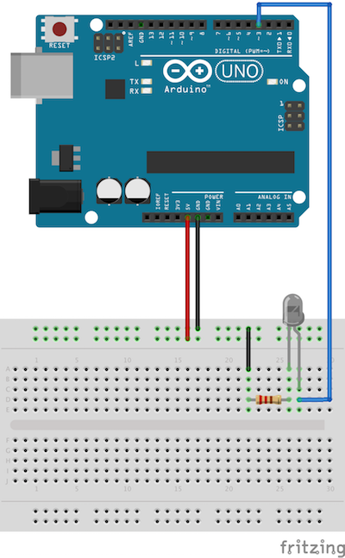
Sending an IR Signal
With the help of the IRremote library and an IR diode, an IR signal can be sent.
Anode of the IR diode is connected to pin 3 of the Arduino.
Note polarity of the IR diode as well as current-limiting resistor.
Check companion web page for source code of the sketch.
The sample sketch will send the sample pattern as used on the previous slide.
Pointing the IR diode to a Samsung TV will turn on the TV!

Slide 44
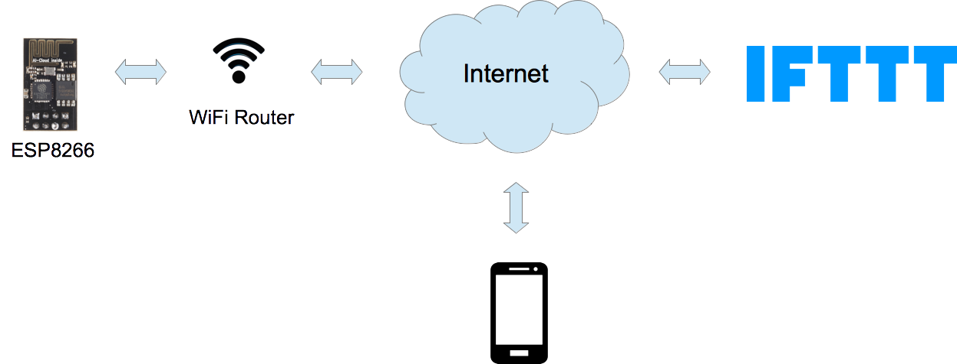
Cloud Demo
The companion web page shows how to connect an ESP8266 with the cloud.
ESP8266 connects via WiFi to the Internet.
ESP8266 performs an HTTP-POST request to IFTTT.com.
HTTP-POST request will trigger a push notification to a mobile phone.
Follow instructions on the companion web page.

Slide 45
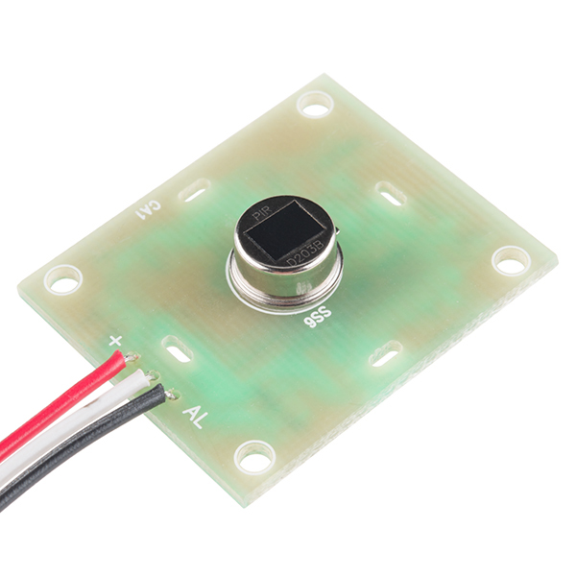
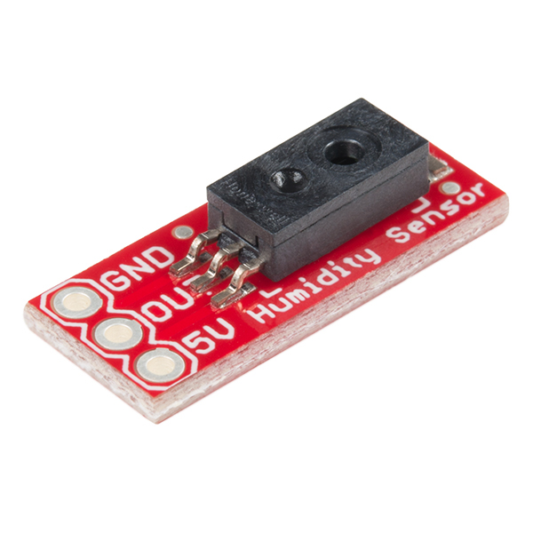
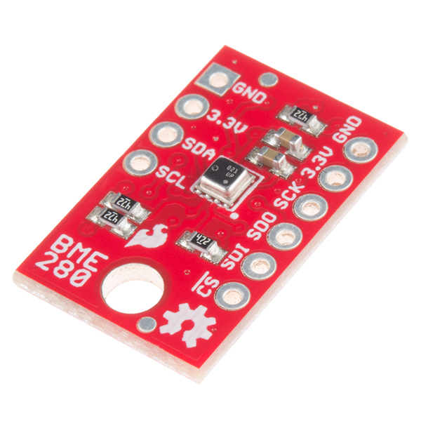
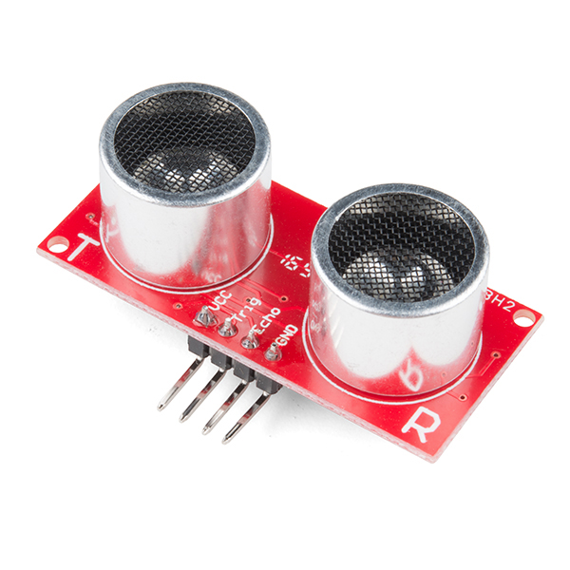
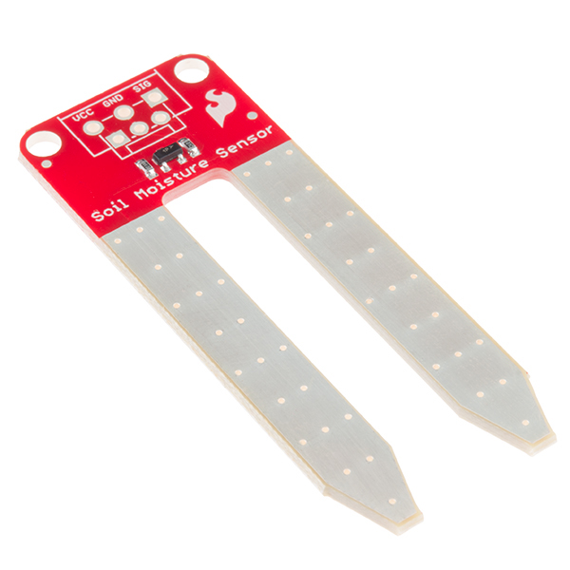
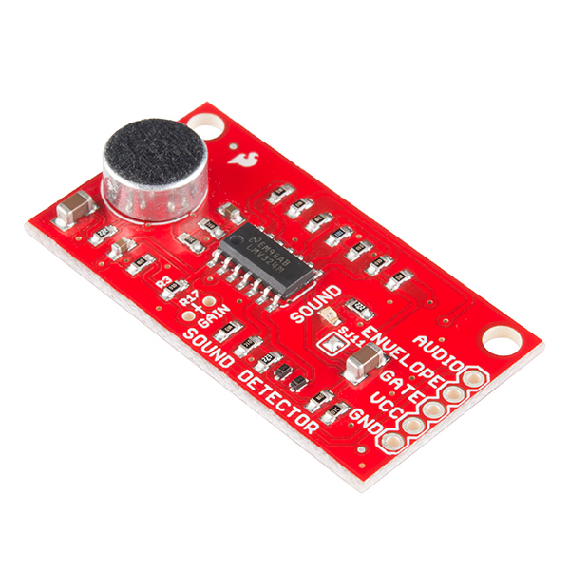
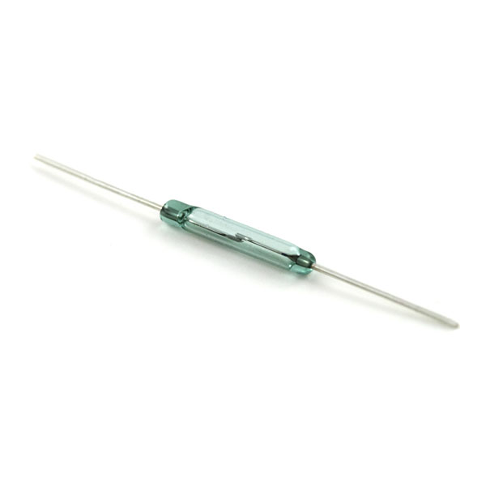
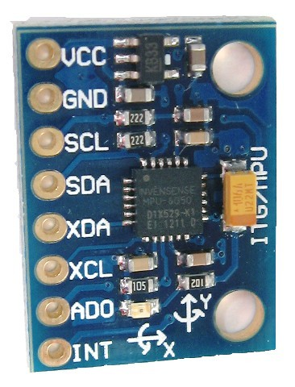
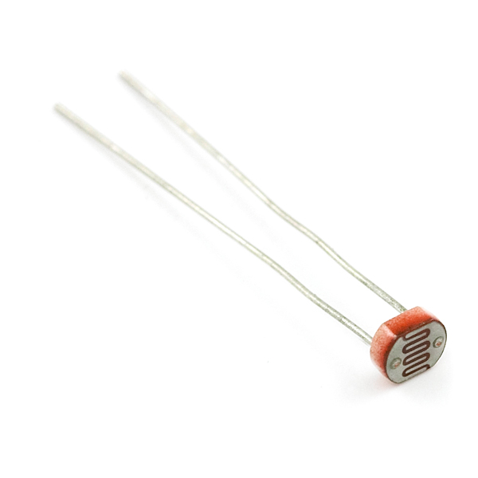
Sensors
Humidity Sensor
HIH-4030
Atmospheric Sensor
BME280
Passive Infrared Motion Sensor
Ultrasonic Sensor
HC-SR04
Soil Moisture
Sound Detector
Accelerometer, Gyroscope
Temperature – MPU6050
Reed Switch
TMP36
Photocell

Slide 46
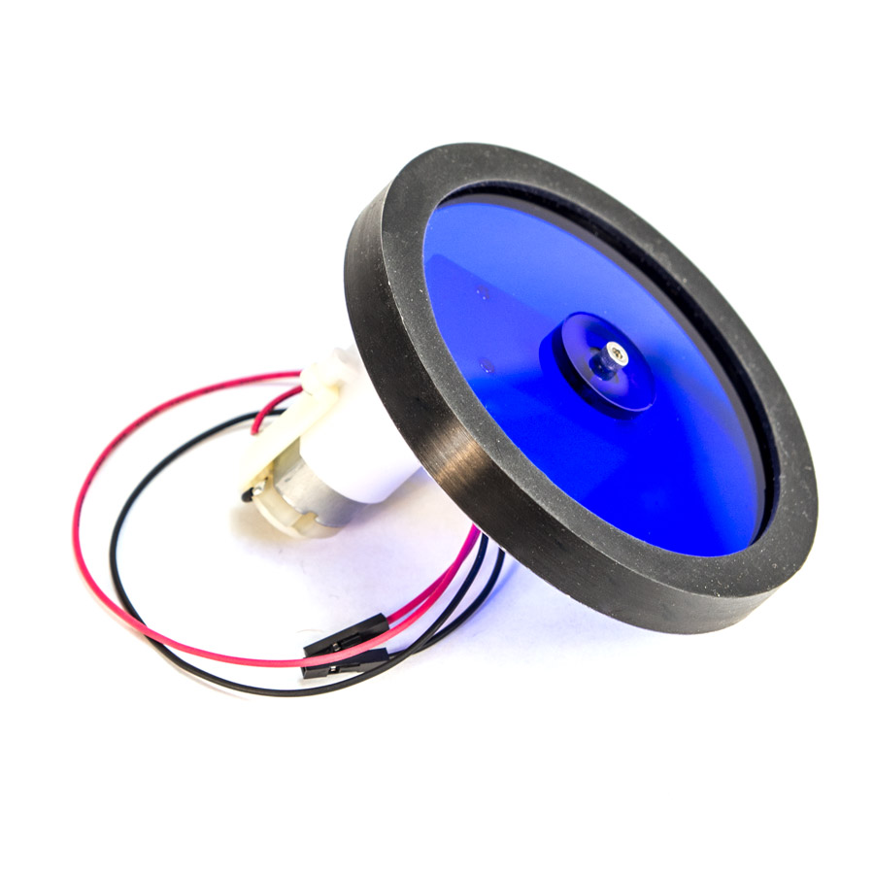
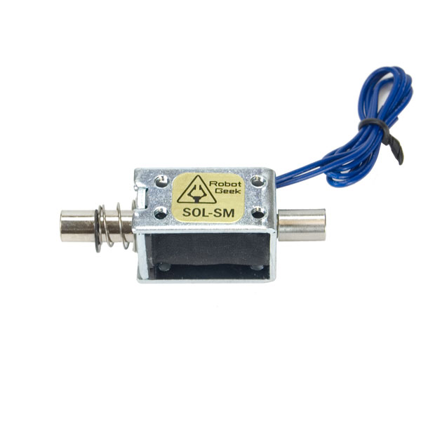
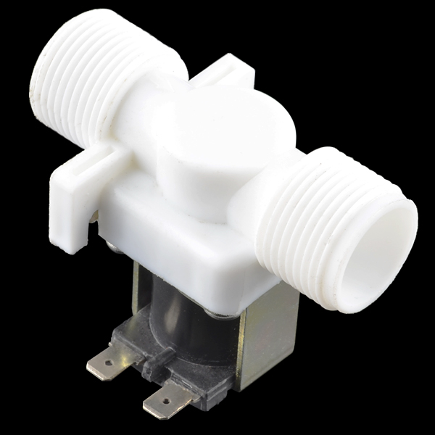
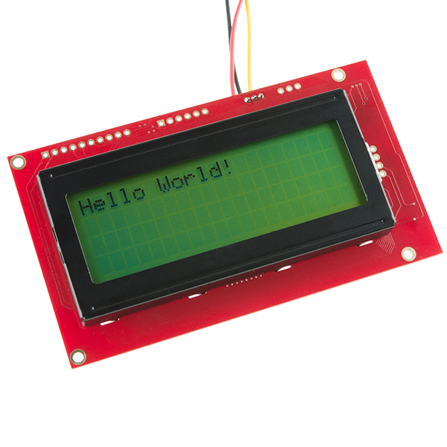
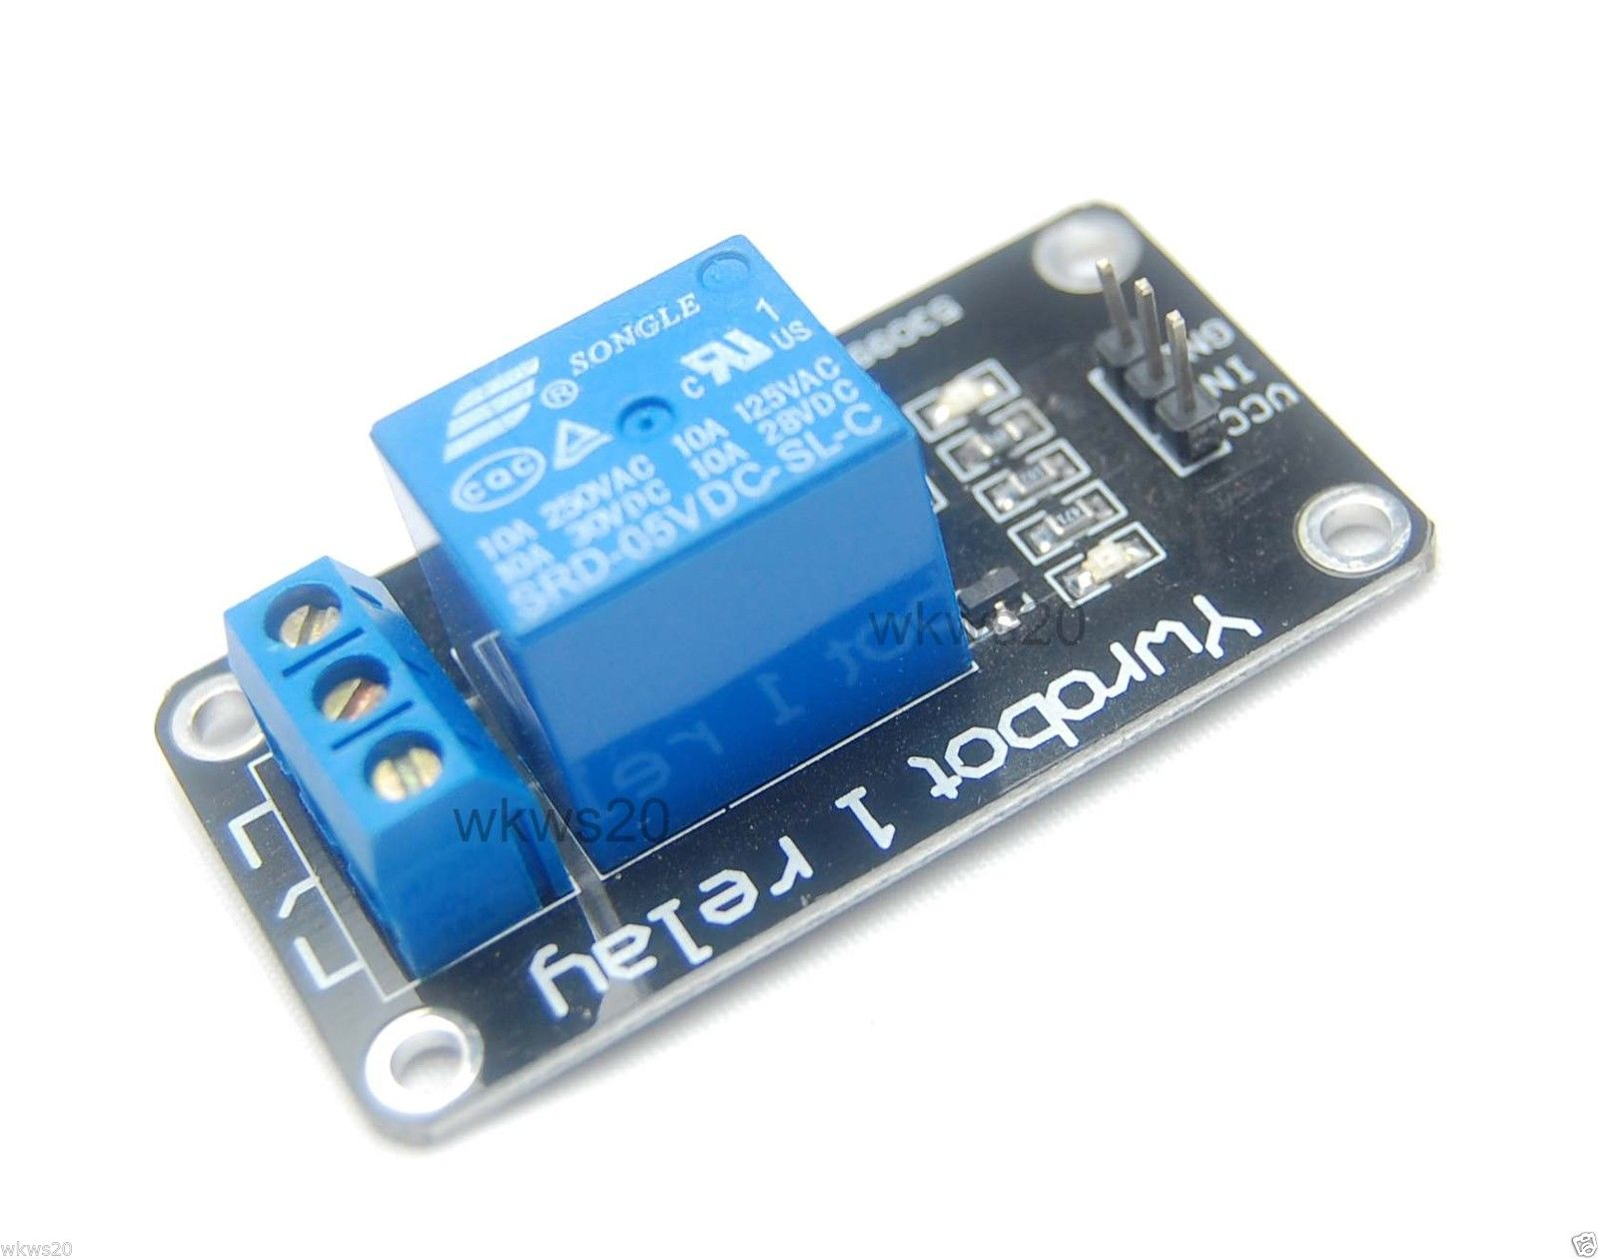
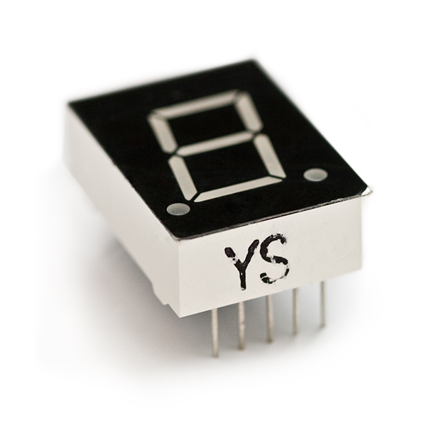
Actuators/Displays
Gear motor
with Wheel Set
Solenoid
Water Valve
Relay
Liquid Crystal Display (LCD)
7 Segment Display

Slide 47
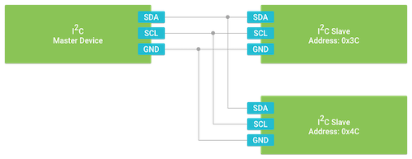
Inter-Integrated Circuit (I2C)
Master/slave, packet switched, half-duplex, serial bus.
3-wire interface:
Shared Clock Signal (SCL)
Shared Data Line (SDA)
Ground (GND)
Master synchronizes slaves by triggering SCL.
Every slave has a unique address.
Master: node that generates the clock and initiates communication with slaves
Slave: node that receives the clock and responds when addressed by the master.
Transmission speed 100 kb/s.

Slide 48
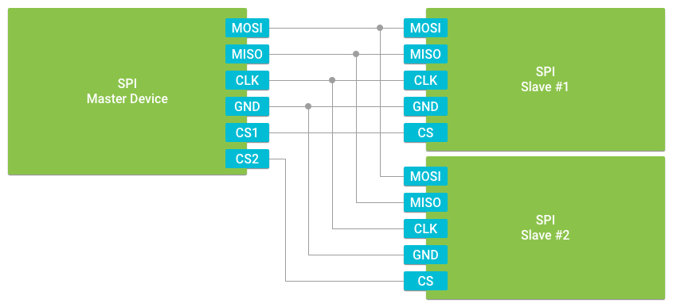
Serial Peripheral Interface (SPI)
Master/Slave, high-bandwidth, full-duplex, serial connection.
4-wire interface:
Serial Clock (CLK): Output from master.
Master Out Slave In (MOSI)
Master In Slave Out (MISO)
Ground (GND)
Slaves are selected via a dedicated Chip Select (CS) wire.
Clock speed: 16MHz – 25MHz

Slide 49
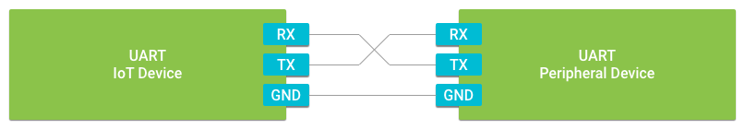
Universal Asynchronous Receiver Transmitter (UART)
Point-to-point, full-duplex connection between two devices.
Universal: both data transfer speed and data byte format are configurable.
Asynchronous: no clock signal present to synchronize data transfer.
3-wire interface:
Receive (RX)
Transmit (TX)
Ground (GND)
Two additional wires for hardware flow control:
Request To Send (RTS)
Clear To Send (CTS)
Faster than I2C.

Slide 50
Comparison Peripheral I/O
Protocol | Transfer Type | # of Wires | # of Peripherals | Transfer Speed
I2C | Synchronous | 2 | Up to 127 | Low
SPI | Synchronous | 4+ | Unlimited | High
UART | Asynchronous | 2 or 4 | 1 | Medium

Slide 51
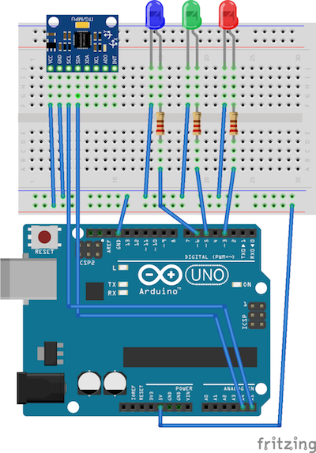
Activity Monitor
LEDs indicate different human activities (standing/walking/hopping).
Accelerometer is used to collect motion data.
Arduino runs neural network to classify human activity.
MPU6050:
3-axis accelerometer.
Uses I2C.
I2C on Arduino Uno:
SDA: pin A4.
SCL: pin A5.
Wire library provides easy access to I2C.
https://www.arduino.cc/en/Reference/Wire
https://github.com/apuder/ActivityMonitor

Slide 52
Misc
Arduino IDE
Fritzing
PlatformIO
Simulator: http://duino4projects.com/arduino-simulator/

Slide 53
Security
IoT’s greatest challenge: SECURITY!!!
Problem: IoT devices are full-fledged computers that rarely get updated.
Popular Foscam web cam:
“The sheer number of vulnerabilities [of this product] offers an attacker multiple alternatives in compromising the device.”
“The researchers went on to say that they notified Foscam representatives of the vulnerabilities several months ago and that, to date, the manufacturer hasn't fixed any of them.”
Compromised IoT devices are turned into a Botnet and used for DDoS attacks (Distributed Denial of Service).
Vulnerable is anything that is connected to the Internet: fridges, lights, cars, medical devices, …
US Senators introduce bipartisan legislation to improve cybersecurity of IoT devices (8/17).
https://arstechnica.com/information-technology/2017/06/internet-cameras-expose-private-video-feeds-and-remote-controls/
https://en.wikipedia.org/wiki/Mirai_(malware)
https://www.gardner.senate.gov/newsroom/press-releases/senators-introduce-bipartisan-legislation-to-improve-cybersecurity-of-internet-of-things-iot-devices

